Slide 1
Convolution and Correlation

Slide 2
Correlation 1. It is the process of moving a filter/mask over the image and computing the sum of products 2. Major Similarities between two signals. 3. Orthogonal signals uncorrelated 4. Mask/Filter is not reversed Convolution 1. It is the process of moving a filter/mask (180 degree rotated) over the image and computing the sum of products 2. Major the effect of one signal on other 3. Mask/Filter is reversed

Slide 3
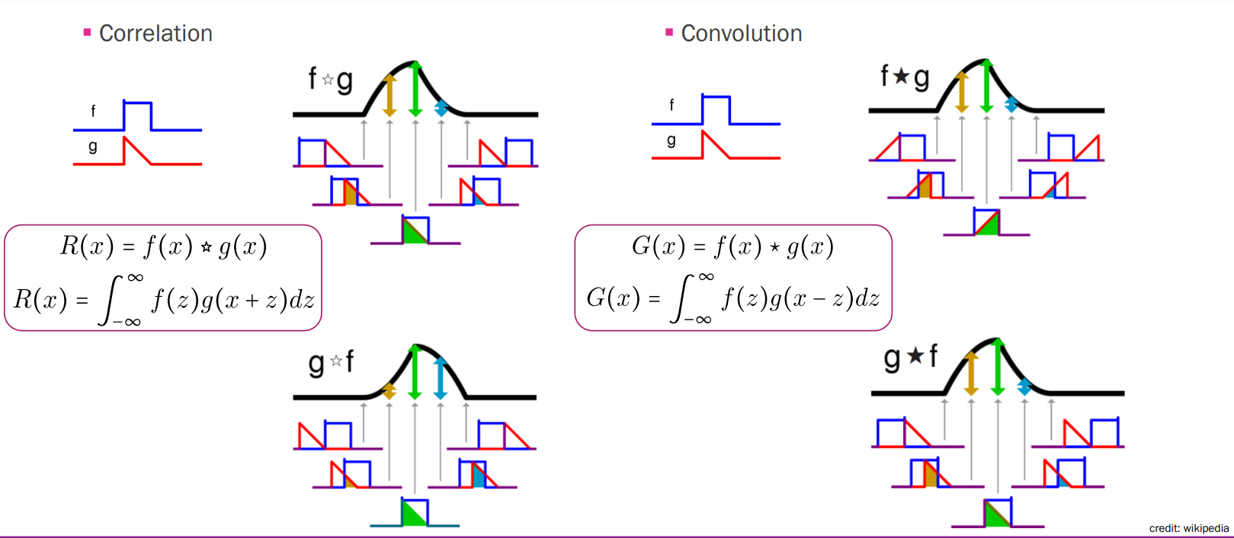
Convolution and Correlation

Slide 4
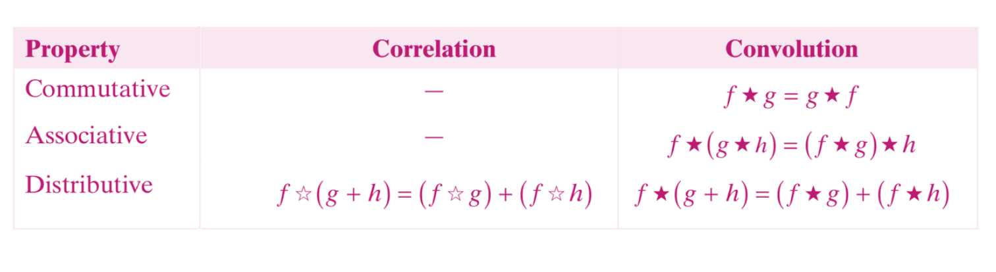
Some Properties of Convolution and Correlation

Slide 5
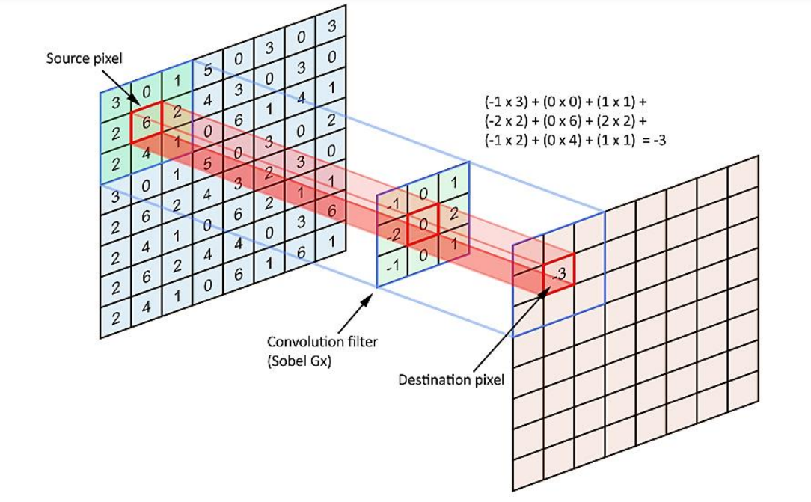
How Convolution/Correlation is calculated?

Slide 6
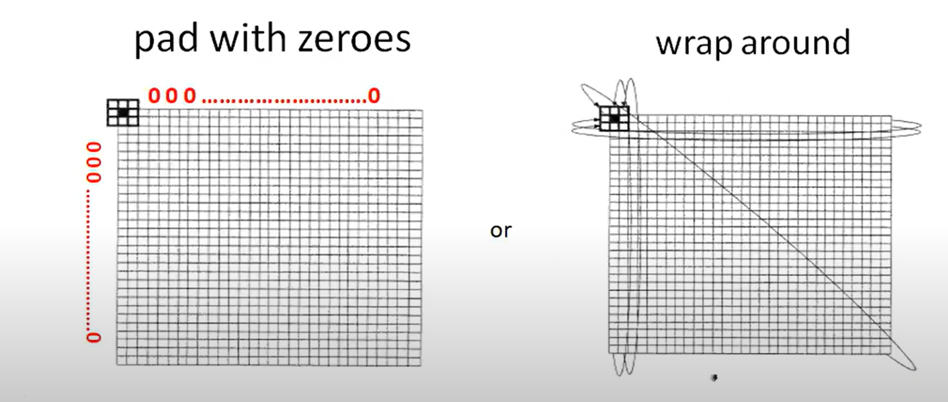
Padding
Zero Padding
Replicate/wrap padding

Slide 7
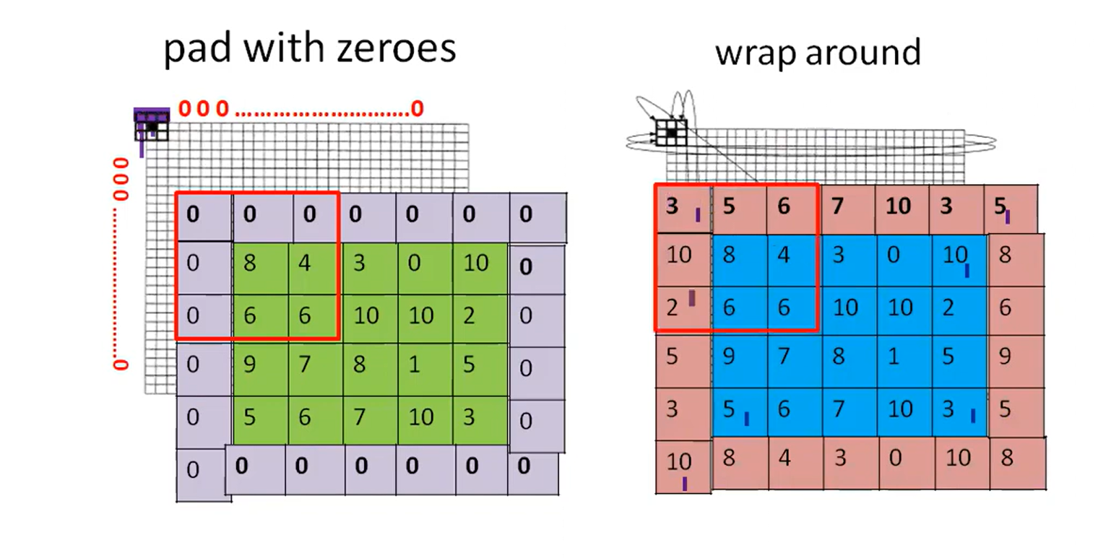
After Padding…..

